Slide 2
RMD SINHGAD SCHOOL OF ENGINEERING DEPARTMENT OF INFORMATION Technology
Restaurant Revenue Prediction
Group Members:
Rushikesh Sarode
Varunkumar Sonawane
Adesh Pawar
Tanmay Borse
Guidance:
Prof. Shrutika Nalwade

Slide 3
introduction
Right now, deciding when and where to open new restaurants is largely a subjective process based on the personal judgement and experience of development teams. This subjective data is difficult to accurately extrapolate across geographies and cultures.
New restaurant sites take large investments of time and capital to get up and running. When the wrong location for a restaurant brand is chosen, the site closes within 18 months and operating losses are incurred.
Here the dataset with 137 restaurants in the training set, and a test set of 100000 restaurants. The data columns include the open date, location, city type, and three categories of obfuscated data: Demographic data, Real estate data, and Commercial data. The revenue column indicates a (transformed) revenue of the restaurant in a given year and is the target of predictive analysis.

Slide 4
descriptions
LANGUAGE USE
Python 3
SOFTWARE USE
Jupyter Notebook (Anaconda 3)
Python 3.9
HARDWARE USE
LAPTOP-R9ESLPV8
64-bit OS, x64 based processor

Slide 5
Continue …
DATASET
train.csv - the training set. Use this dataset for training your model.
DATA FIELDS
Id : Restaurant id.
Open Date : opening date for a restaurant
City : City that the restaurant is in. Note that there are Unicode in the names.
City Group: Type of the city. Big cities, or Other.
Type: Type of the restaurant, FC: Food Court, DT: Drive Thru, MB: Mobile
Revenue: The revenue column indicates a (transformed) revenue of the restaurant in a given year and is the target of predictive analysis.

Slide 6
Data features …
P1, P2 … P37: There are three categories of these obfuscated data.
Demographic data are gathered from third party providers with GIS systems. These include population in any given area, age and gender distribution, development scales.
Real estate data mainly relate to the price of the location, front facade of the location, car park availability.
Commercial data mainly include the existence of points of interest including schools, banks, other QSR operators.

Slide 7
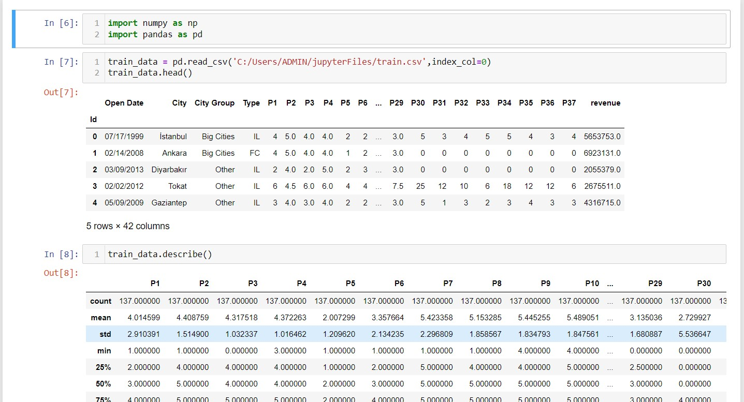
Screenshots

Slide 8
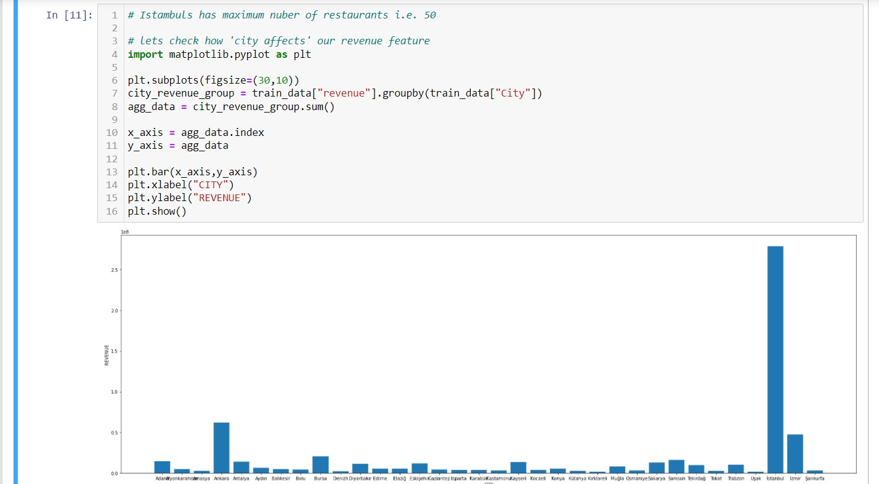

Slide 9
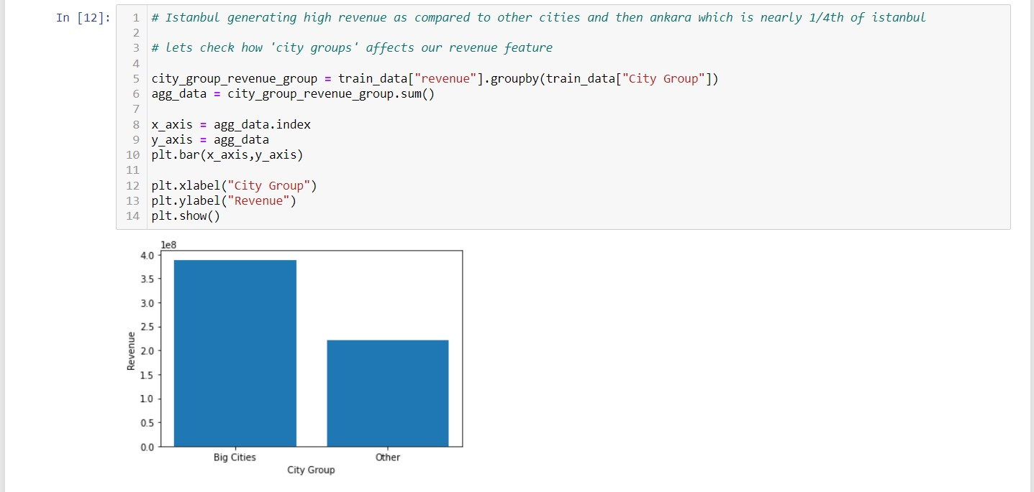

Slide 10
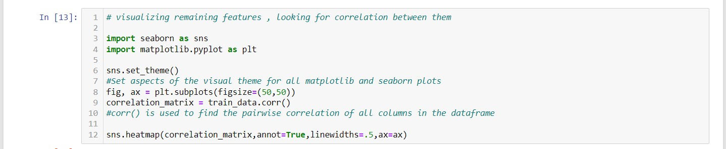
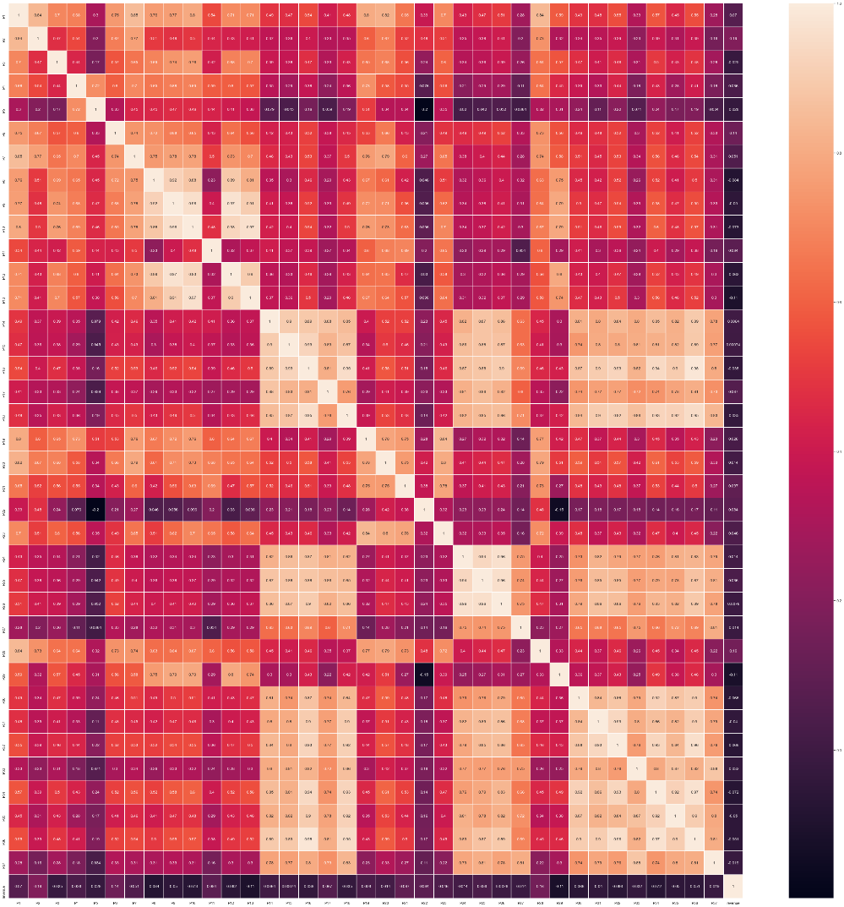

Slide 11
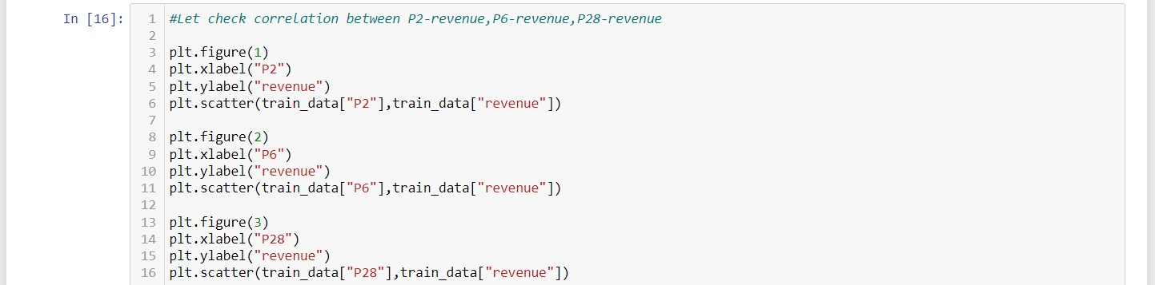
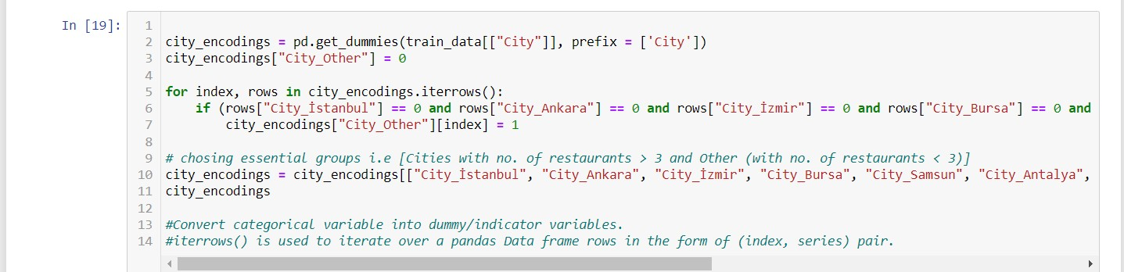

Slide 12
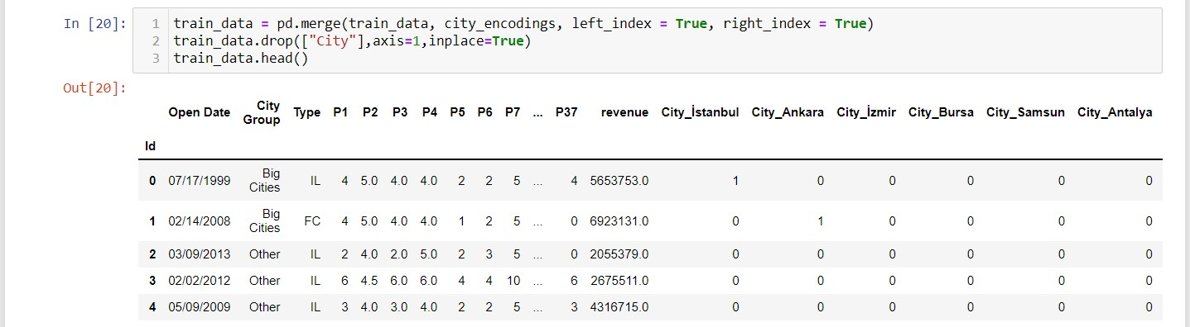

Slide 13
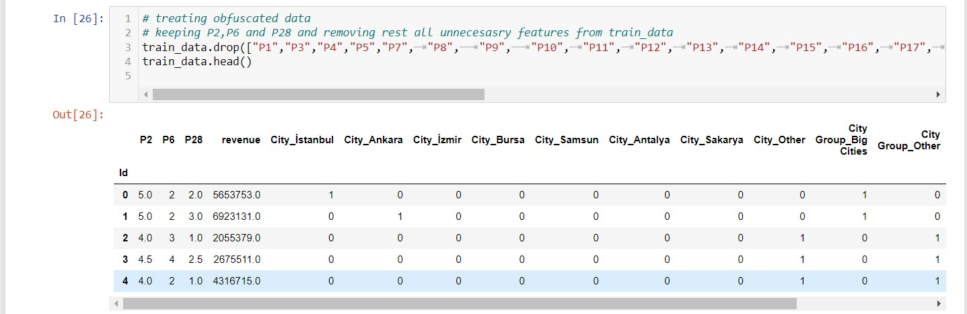

Slide 14
Applications
It aims to find an algorithmic model to increase the effectiveness of investments in new restaurant sites.
The revenue prediction will decrease the risk of investment in stock market.

Slide 15
Future Aspect
Creating effective model from these preprocess data.
Work on frontend method that can be user friendly.
Monthly data updating for low risk factor.

Slide 16
THANK YOU !

